Slide 1
IBM NaanMuthalvan – Artificial Inteligence Group 4 College name : SSM Institute Of Engineering And Technology College code : 9221 Team Members : J.Margrate Sneka (922121106045) S.Nagapriya (922121106056) M.Pooja (922121106064) C.M.Priyadharshini (922121106069)
Phase 4: MEASURE ENERGY CONSUMPTION

Slide 2
Development and Real world implementation:
Real-Time Monitoring:
Implement real-time monitoring capabilities to allow users to track energy consumption patterns as they occur. This can involve dashboards or alert systems that notify stakeholders of unusual energy usage.
Data Analysis and Visualization:
Develop tools for analyzing and visualizing the collected data. This could include creating charts, graphs, or reports that help stakeholders understand energy consumption trends and patterns.
Machine Learning Models:
Consider implementing machine learning models to predict future energy consumption based on historical data. This can enhance the system's ability to provide actionable insights and optimize energy usage.
User Interface:
Create a user-friendly interface for stakeholders to interact with the energy consumption data. This could be a web portal, a mobile app, or integrated into existing management systems.

Slide 3
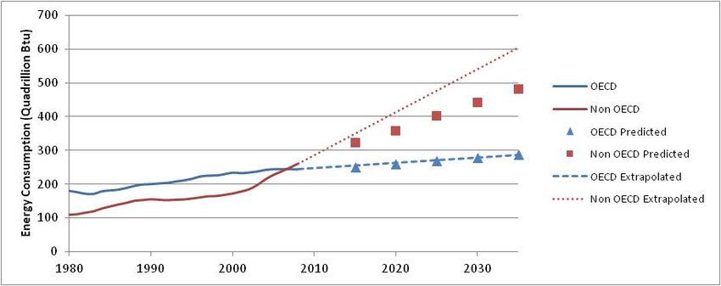
Security Measures:
Implement robust security measures to protect the collected energy data. Encryption, secure access controls, and regular security audits are essential components.
Monitoring and Maintenance:
Establish a monitoring system to detect anomalies or malfunctions in the energy measurement system. Regular maintenance checks and software updates are crucial for optimal performance.
Feedback Mechanism:
Implement a feedback mechanism to continuously improve the system based on user input and changing energy consumption patterns.

Slide 4

Machine learning Algorithm:
Support Vector Machines (SVM):
SVM is a powerful algorithm for classification and regression tasks. It works by finding a hyperplane that best separates the data points and predicts energy consumption based on their position relative to the hyperplane.
Training the Model:
In SVM, the goal is to find the best hyperplane that separates the data points into different classes (e.g., high and low energy consumption). The algorithm finds the hyperplane by maximizing the margin between the classes while minimizing the misclassification of data points.
Model Evaluation:
Once the SVM model is trained, evaluate its performance on the testing set. Use metrics such as accuracy, precision, recall, or mean squared error to assess how well the model predicts energy consumption.

Slide 5
Conclusion:
1. Data Collection:
One challenge could be gathering accurate and reliable data on energy consumption. It may require coordinating with different sources or devices to collect the necessary data. A lesson learned could be the importance of ensuring data quality and consistency throughout the project.
2. Feature Selection:
Selecting the most relevant features for energy consumption prediction can be a challenge. Choosing the wrong features may lead to inaccurate predictions. A lesson learned could be the importance of carefully analyzing and selecting features based on their impact on energy consumption.
3. Model Selection and Evaluation:
Choosing the right model, such as Support Vector Machines (SVM), and evaluating its performance can be challenging. Different models may have varying strengths and weaknesses. A lesson learned could be the importance of exploring and comparing different models to find the best fit for the project.
4. Interpretation of Results:
Interpreting the results of the energy consumption measurement project can be challenging, especially when dealing with complex data patterns. A lesson learned could be the importance of visualizing and communicating the results effectively to stakeholders, making it easier for them to understand a act upon the finding.

